Slide 1
--Create a videos table.
--This table should include a unique ID, the title of the video, the length in minutes, and the URL.
--Populate the table with at least three related videos from YouTube or other publicly available
--resources.
--Create and populate Reviewers table.
--Create a second table that provides at least two user reviews for each of at least two of the videos.
--These should be imaginary reviews that include columns for the user’s name (“Asher”, “John”, etc.), the
--rating (which could be NULL, or a number between 0 and 5), and a short text review (“Loved it!”). There
--should be a column that links back to the ID column in the table of videos.

Slide 2
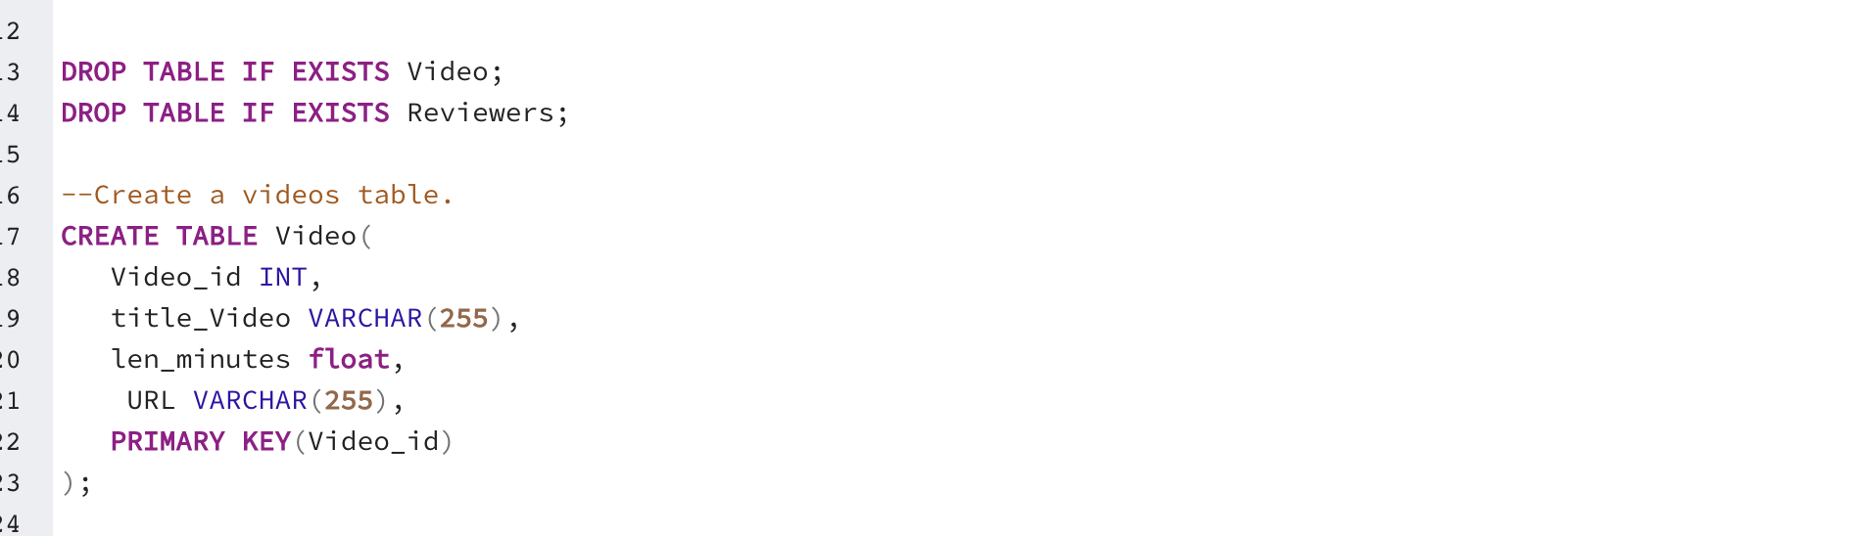

Slide 3
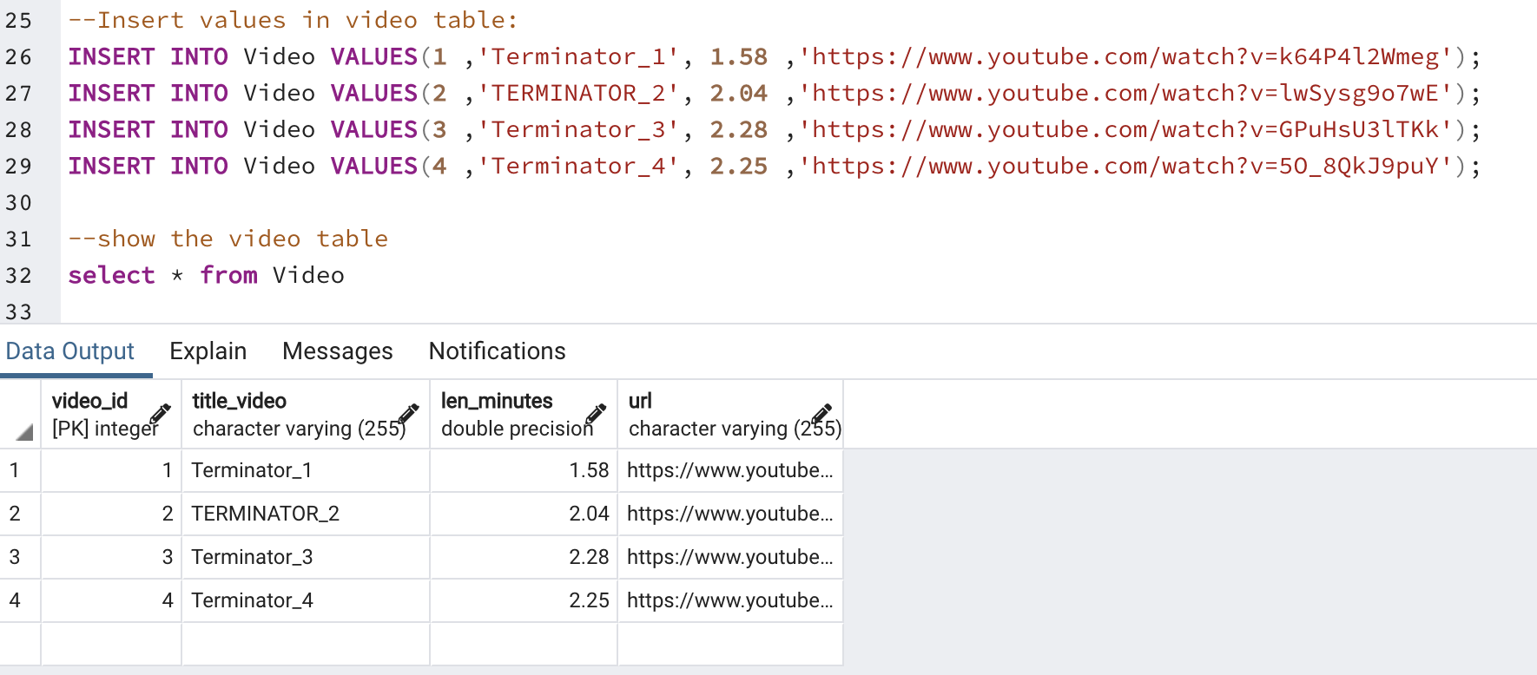

Slide 4
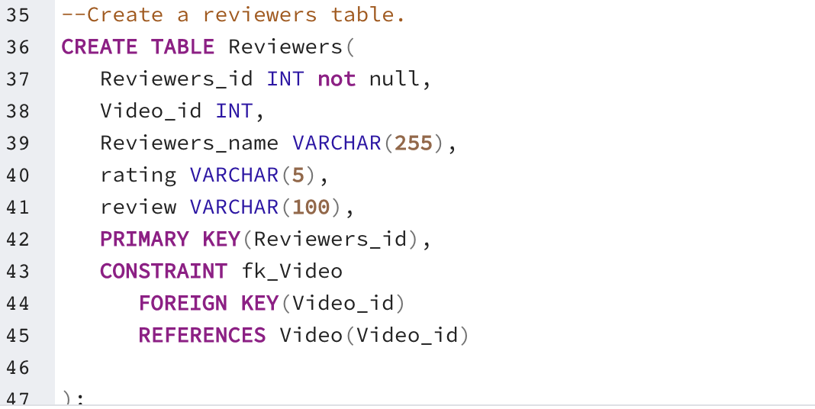

Slide 5
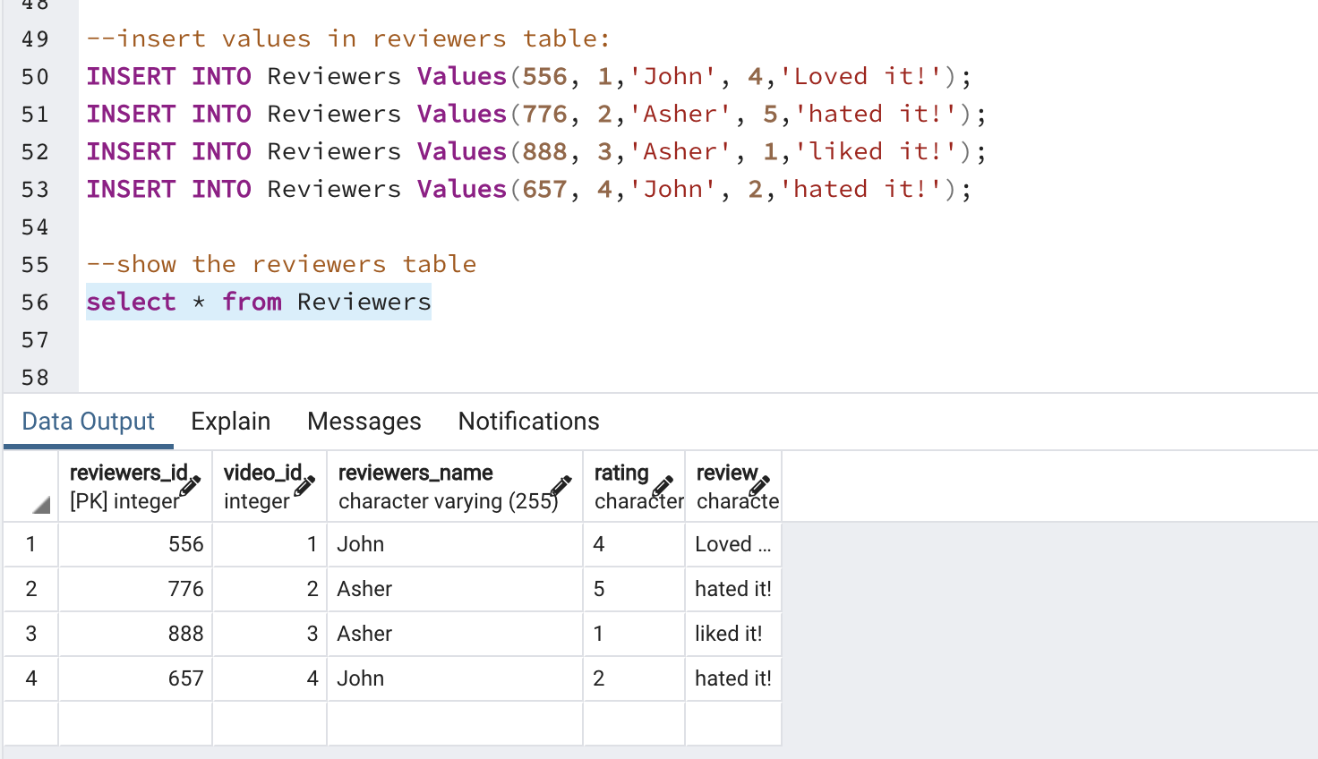

Slide 6
